Slide 1


Dayananda Sagar College of Engineering (An Autonomous Institute affiliated to VTU, Belagavi – 590018, Approved by AICTE & ISO 9001:2015
Certified) Accredited by National Assessment & Accreditation Council (NAAC) with ‘A’ grade & NBA) Mini Project on
Automated Turn-Off Charging Point
Submitted by
Name of the Candidates: USN:
Amrutha N Daivagna 1DS20EE008
Deeksha Purshotham 1DS20EE024
Devika S Kumar 1DS20EE026
Ishika Daga 1DS20EE028
Under the guidance of
Dr. Sujit Kumar (Asst. Prof)
Department of Electrical and Electronics Engineering

Slide 2
Table of Content
Introduction
Objectives
Components
Circuit Diagram
Project Output

Slide 3
Introduction
An automated turn off charging point is a device that is designed to automatically turn off the power supply to a charging point when a device has finished charging. This is done to prevent overcharging of the device's battery, which can reduce its overall lifespan and potentially pose a safety hazard.
Automated turn off charging points can be useful in a variety of applications, including home and office charging stations, public charging stations, and electric vehicle charging stations. By automatically turning off the power supply when charging is complete, these devices can help to save energy, reduce costs, and extend the lifespan of batteries .

Slide 4
Objectives
Prevent overcharging: The primary objective of an automated turn off charging point is to prevent overcharging of electronic devices, such as smartphones and tablets, by automatically turning off the power supply when the battery is fully charged. This helps to extend the lifespan of the battery and prevent safety hazards.
Extend battery life: By preventing overcharging, an automated turn off charging point helps to extend the lifespan of electronic device batteries, reducing the need for frequent battery replacements and reducing electronic waste.
Save energy: An automated turn off charging point helps to save energy by reducing the power consumption of electronic devices. By turning off the power supply when the battery is fully charged, the charging point prevents unnecessary power consumption and reduces energy waste.

Slide 5
Literature Survey
This literature survey examines the need for automatic turn-off chargers in the context of combating overcharging, improving battery life, and ensuring human safety. Overcharging poses risks to both the battery life and the safety of users, making it crucial to explore solutions that can mitigate these issues. This survey investigates relevant studies, technical articles, and reports to highlight the significance of automatic turn-off chargers in addressing these challenges.
Overcharging and Battery Degradation:
Effects of overcharging on battery health
Human Safety Risks:
Overcharging-related safety hazards.
Potential risks of fires or explosions, although explosions are extremely rare but they still exist
Reported incidents and accidents caused by overcharging.
Growing dependence on electronic devices among the elderly
Challenges faced by the elderly like forgetfulness , physical limitations etc

Slide 6

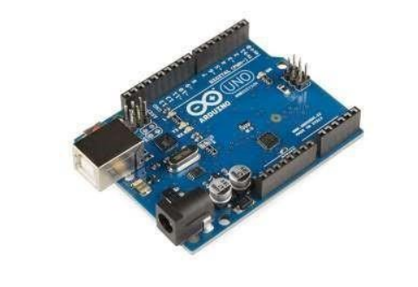
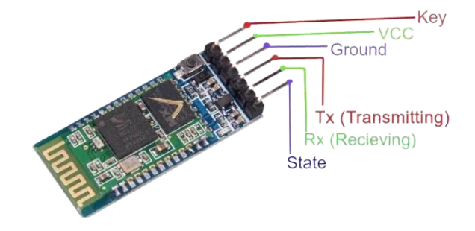
Components
Arduino UNO
Bluetooth Module (HC-05)
Servomotor
Jumper Wires
USB cable

Slide 7
Components Working
Arduino UNO: The Arduino Uno is used for making automated turn-off charging points due to its simplicity, versatility, and affordability. It provides processing power and allows you to program it to control various components and devices.
Bluetooth Module (HC-05): The Bluetooth module enable wireless communication between the charging point and a mobile device. It has a typical range of about 10 meters (approximately 33 feet) in open space without obstructions.
Servomotor : A servomotor is connected to a mechanical switch or lever in the charging point. By programming the servomotor's position, you can control the switch's state, turning the charging point on or off. When the charging point receives a command (e.g., battery fully charged), the servomotor can rotate to a predetermined angle, activating or deactivating the switch accordingly

Slide 8
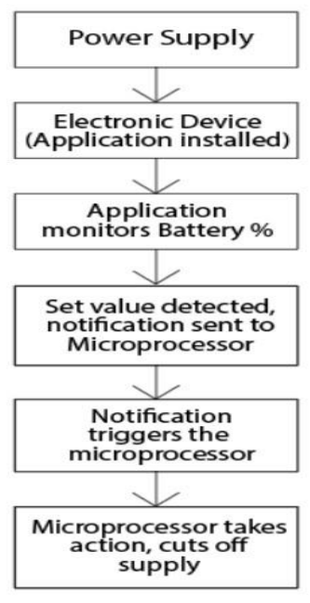
BLOCK DIAGRAM
Power supply
Arduino UNO
Bluetooth
module
Servo Motor

Slide 9
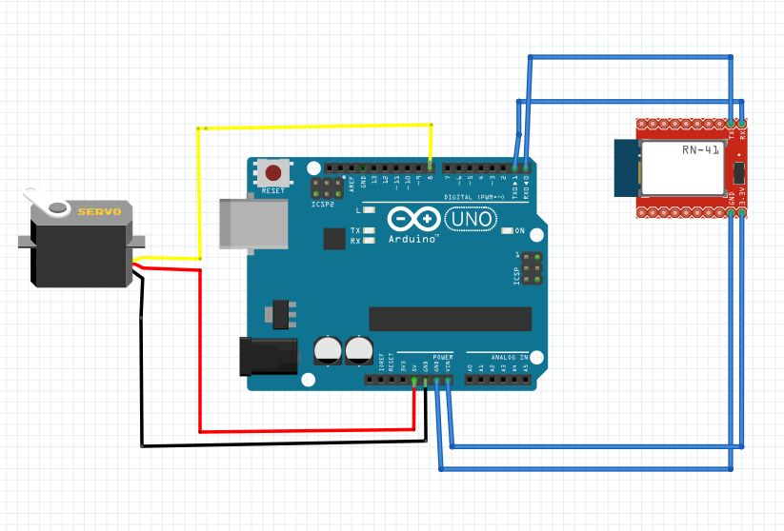
Circuit Diagram

Slide 10
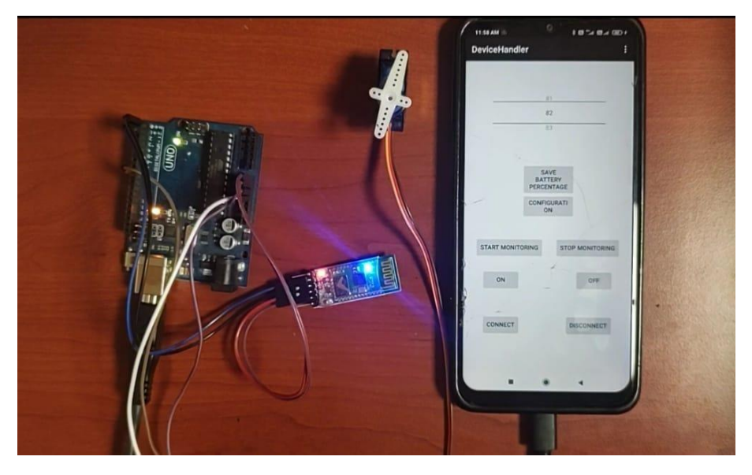
Working Model

Slide 11
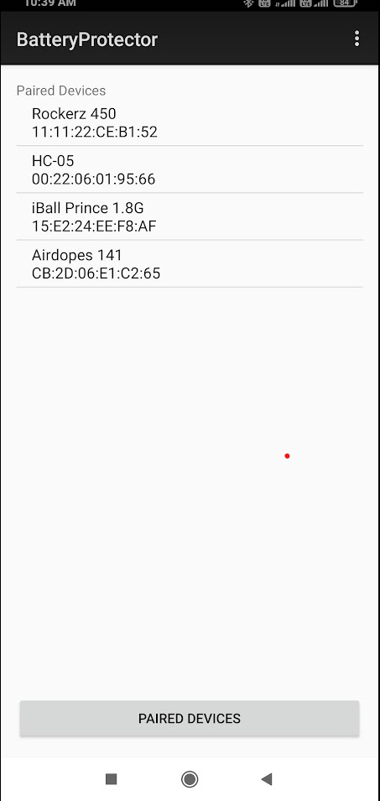
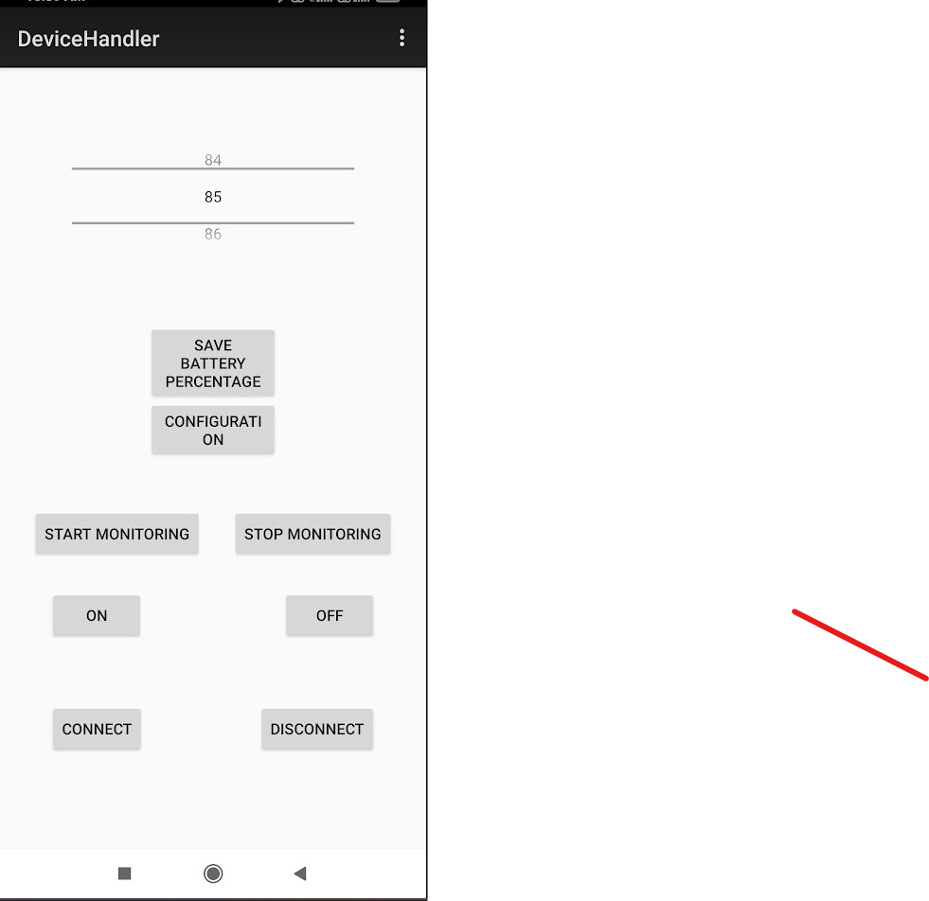
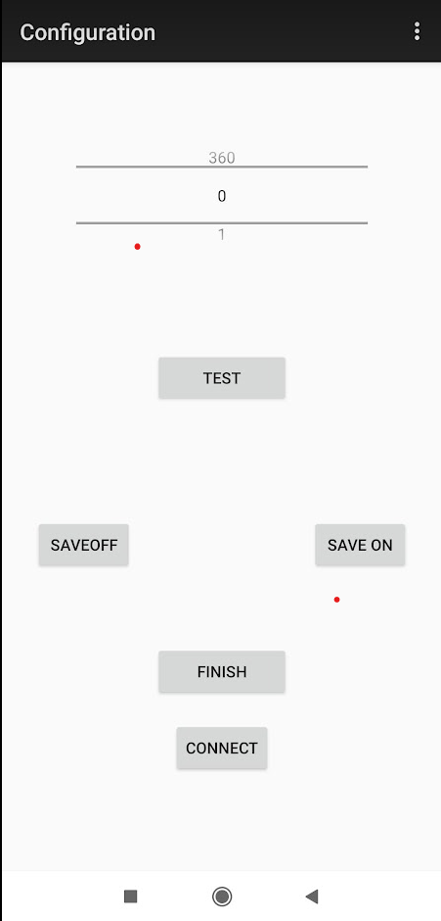
.. ..

Slide 12


.. ..

Slide 13
Project Output
The purpose of the project is to automatically stop or disconnect the charging process of mobile phone once the battery reaches a certain level.
Using the mobile app, one can monitor the charging level. This helps prevent overcharging, reduces energy waste, and ensures the battery is not continuously kept at a high charge level, which can degrade its performance over time.
It aims to optimize battery performance by ensuring that the battery is charged within its recommended limits.

Slide 14
THANK YOU

